Slide 1
Final Project
Presented by Mohsine Taarji
Tuesday 7,2018

Slide 2
OUTLINE
Cleaning the data
Linear Regression
Logistic Regression
Neural Network

Slide 3
Cleaning the data

Slide 4
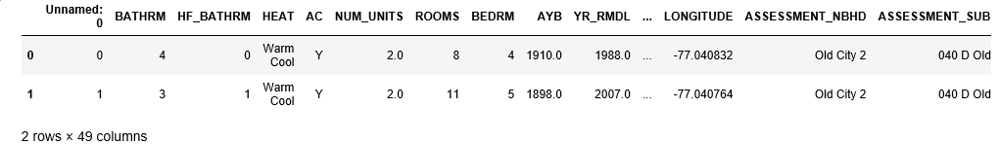
Overview of the data

Slide 5
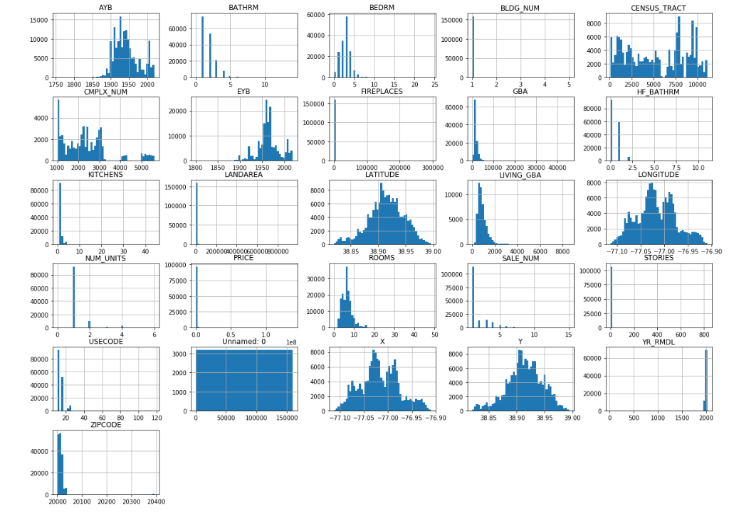
Explore the data

Slide 6
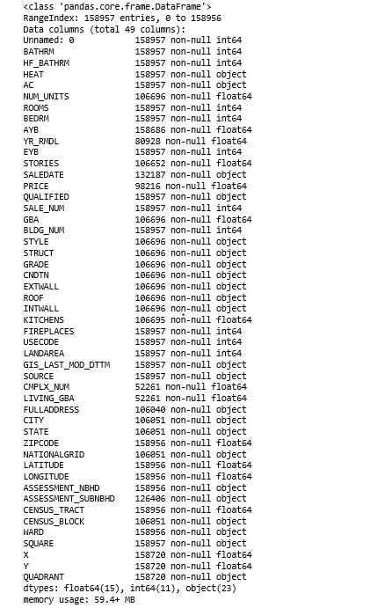
Explore the data

Slide 7
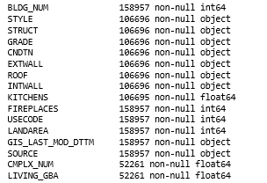
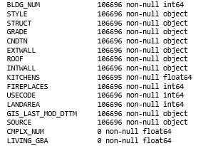
Clean the data
Keep Residential

Slide 8
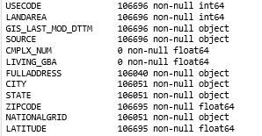
Clean the data (con’t)
Drop Complex num and living GBA

Slide 9
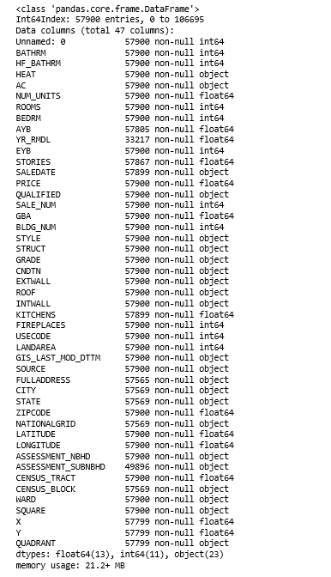

Clean the data (con’t)
Drop all rows that nan in PRICE

Slide 10
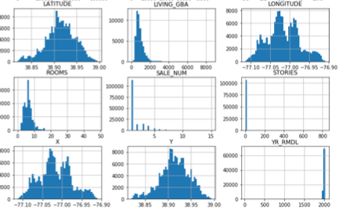
Clean the data (con’t)
Drop X,Y they are similar to latitude and longitude

Slide 11
Clean the data (con’t)
Drop Source because it only has one unique value

Slide 12
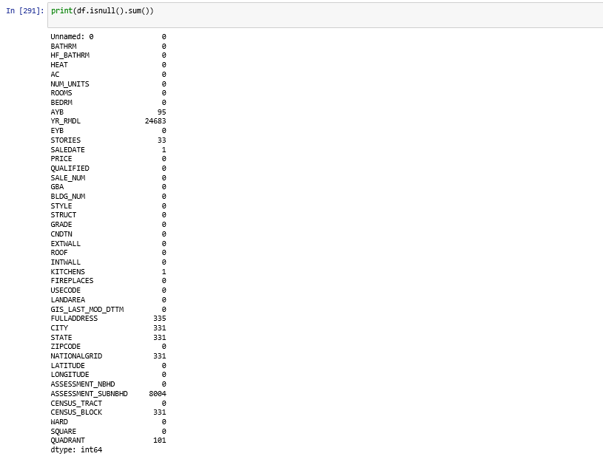
Clean the data (con’t)
Missing values

Slide 13
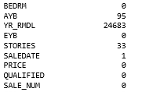
Clean the data (con’t)
Drop Unnamed because it work as index and we have already an index.
Drop YR_RMDL because it missing a lot data

Slide 14
Clean the data (con’t)
Drop rows of nan in kitchen saledate because it only has one nan

Slide 15
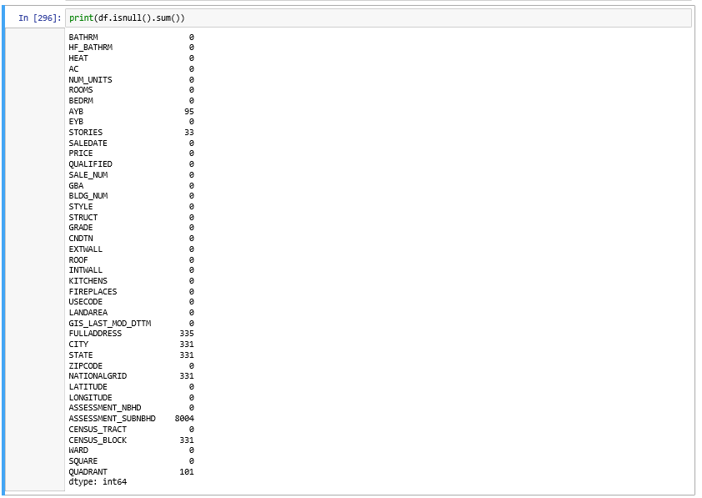
Clean the data (con’t)
Output from missing rows

Slide 16
Clean the data (con’t)
Take all nan from non-full columns
Drop the columns that they will not be useful
Fulladdress : we already has zip code and NBHD
City, State : it’s only have one unique data
SUBNBHD, NATIONALGRID : missing a lot of data.

Slide 17
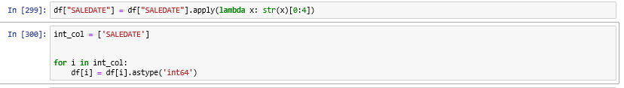
Clean the data (con’t)
Change SALEDATE to int and use just the year

Slide 18
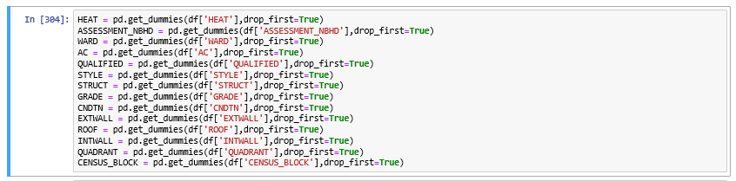
Clean the data (con’t)
Create dummies from non int values

Slide 19
Clean the data (con’t)
Drop all the main columns and also drop GIS_Last mod because it only has one unique value

Slide 20
Clean the data (con’t)
Concat the old data we the new dummies

Slide 21
Linear Regression

Slide 22
Implement Linear Regression
Define our X and y

Slide 23
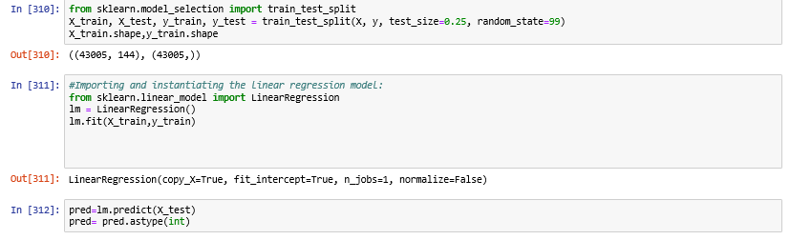
Implement Linear Regression
Use sklearn to get the prediction

Slide 24
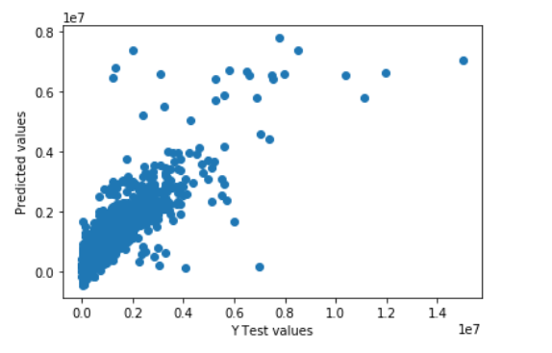
Implement Linear Regression
Plot the y_test vs prediction

Slide 25
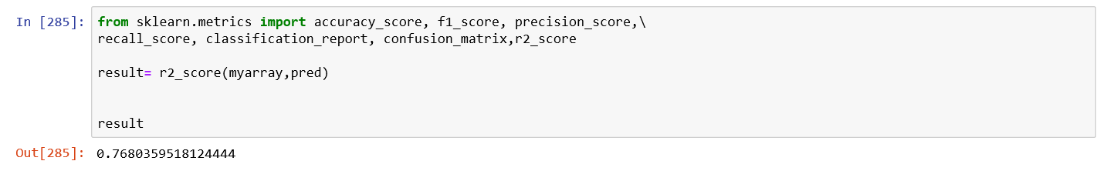
Implement Linear Regression
Calculate the accuracy

Slide 26
Logistic Regression

Slide 27
Logistic Regression
Classification
Method 1: Sort the price values then divide the size of the price to 10 even categories
Method 2: Take the max price and divided by 10

Slide 28
Method 1

Slide 29
Implement Logistic Regression
Classification
First check the size of
Second retrieve all the values from the PRICE

Slide 30
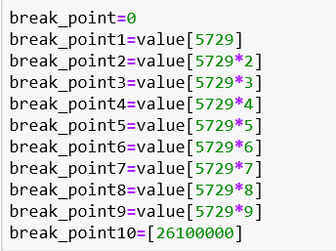
Implement Logistic Regression
Third Sort all the values of the price
Fourth create break points
0 %
10 %
20 %
30 %
40 %
50 %
60 %
70 %
80 %
90 %
100 %

Slide 31
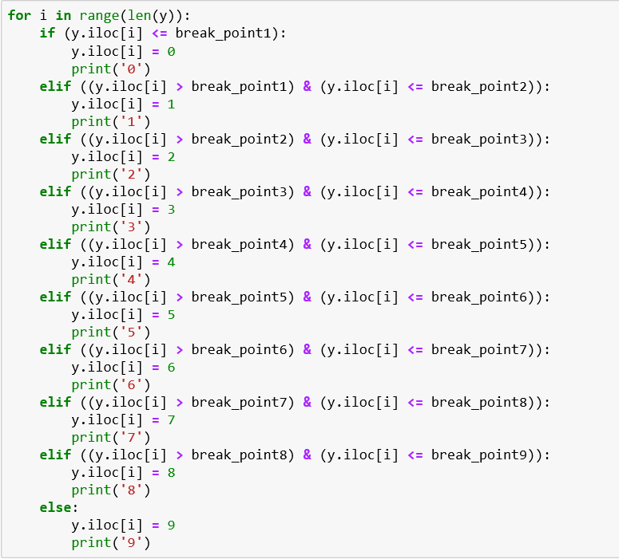
Implement Logistic Regression
Create Classes based on the break_points

Slide 32
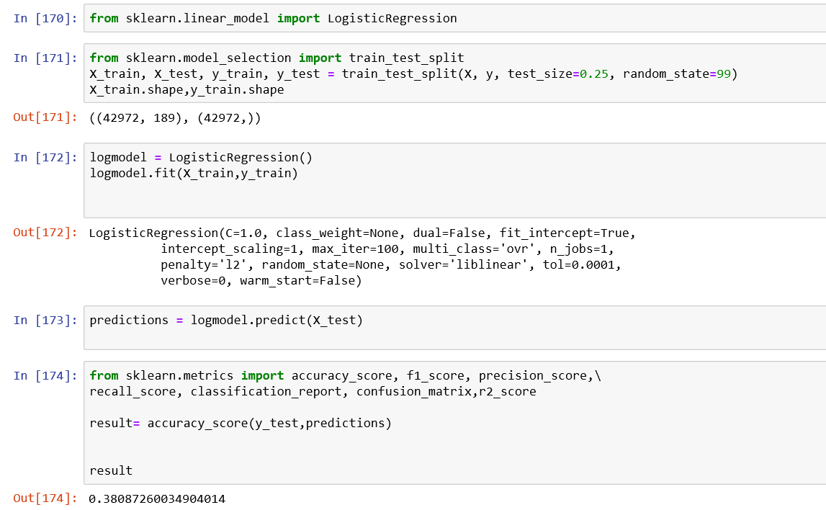
Implement Logistic Regression
Scikit learn implementation for logistic regression

Slide 33
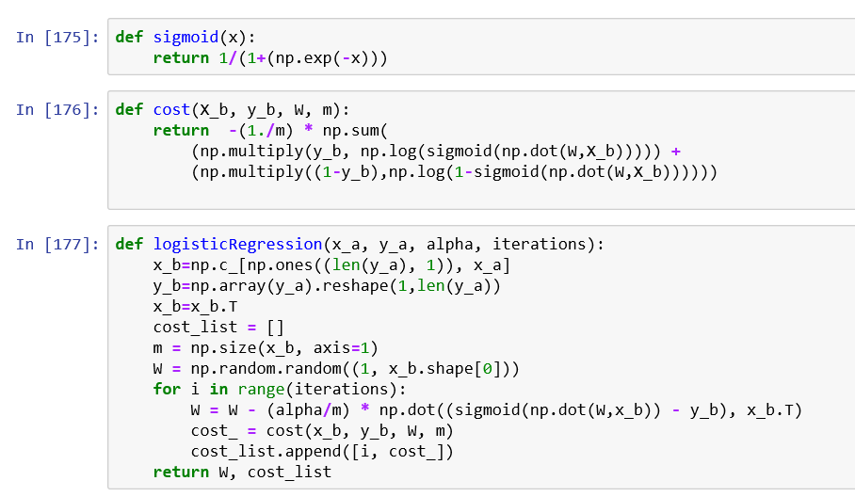
Implement Logistic Regression
Python implementation for logistic regression

Slide 34
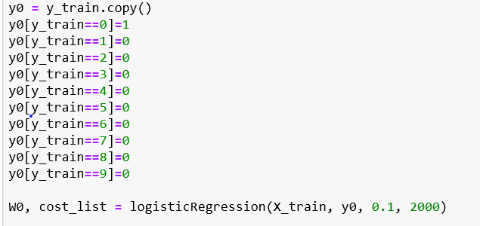
Implement Logistic Regression
Python implementation for logistic regression

Slide 35
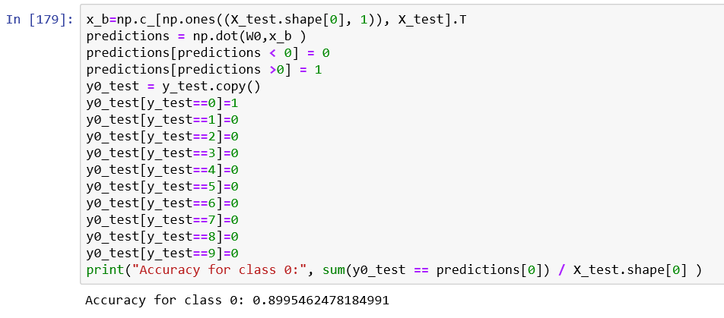
Implement Logistic Regression
Python implementation for logistic regression

Slide 36
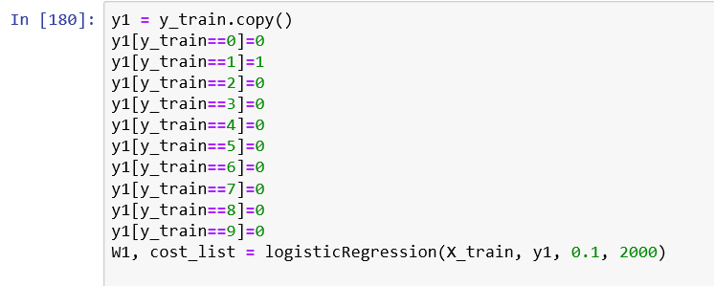
Implement Logistic Regression
Python implementation for logistic regression

Slide 37
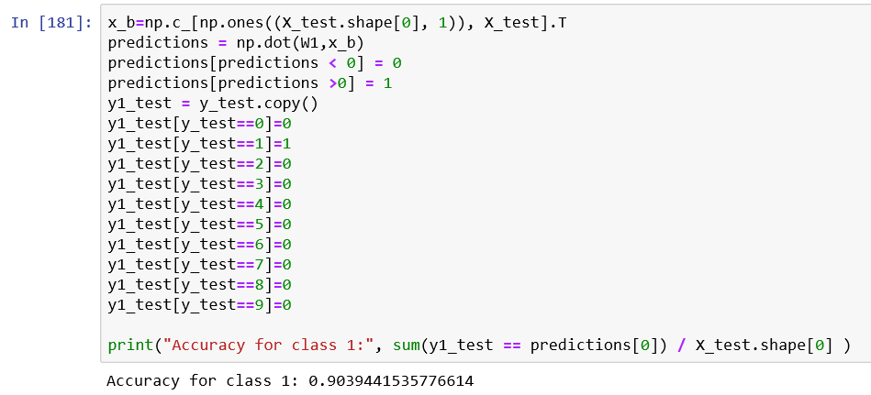
Implement Logistic Regression
Python implementation for logistic regression

Slide 38
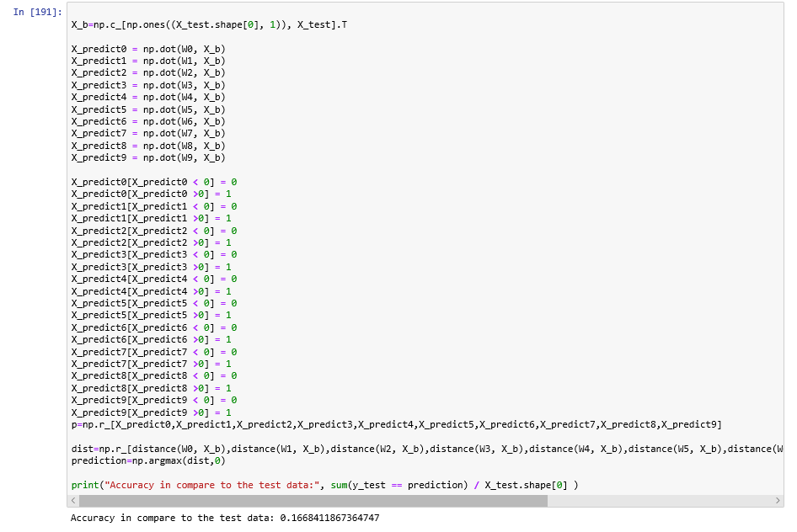
Implement Logistic Regression
Accuracy for Python implementation for logistic regression

Slide 39
Method 2

Slide 40
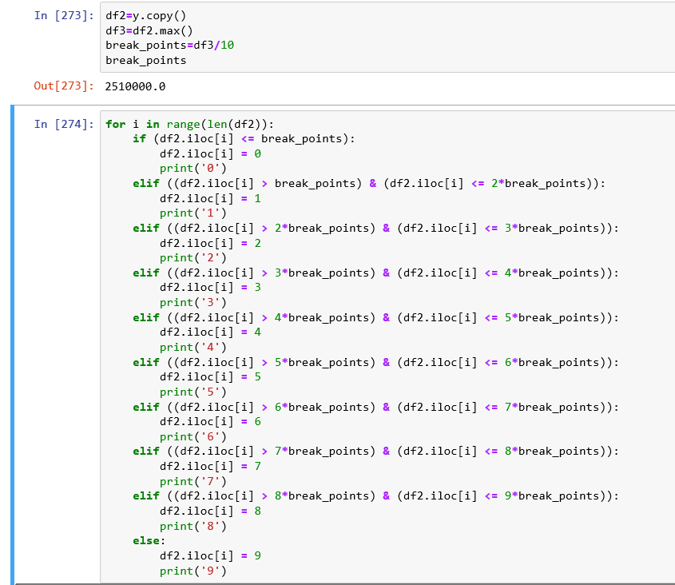
Clasification

Slide 41
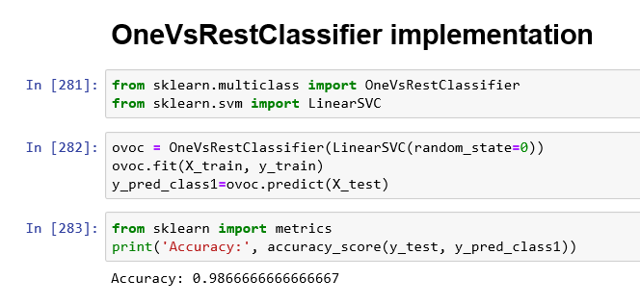
Accuracy with scikit learn

Slide 42
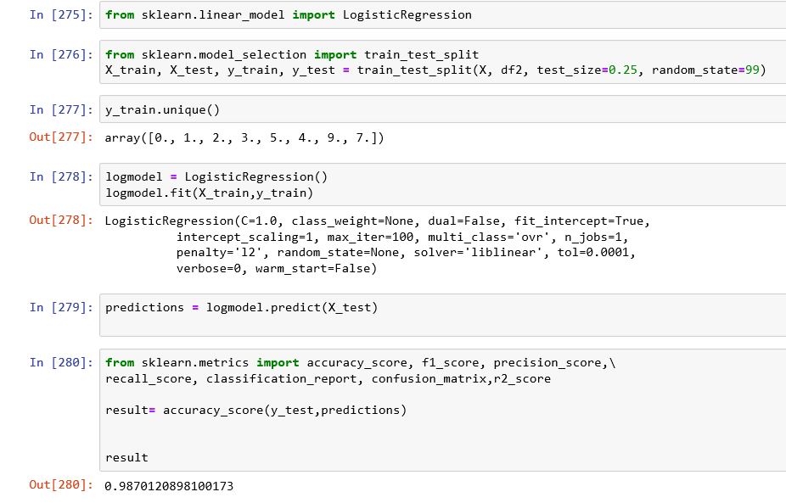
Accuracy with scikit learn

Slide 43
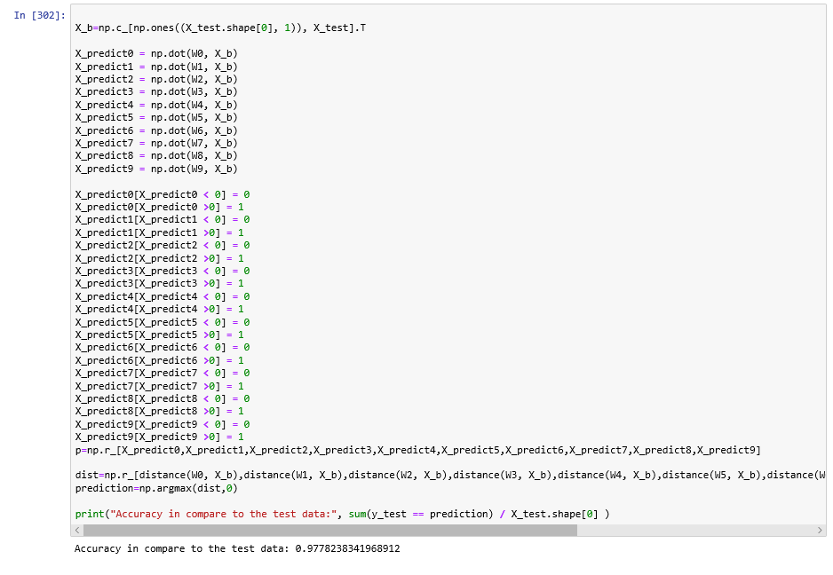
Accuracy with python implementation

Slide 44
Neural Network

Slide 45
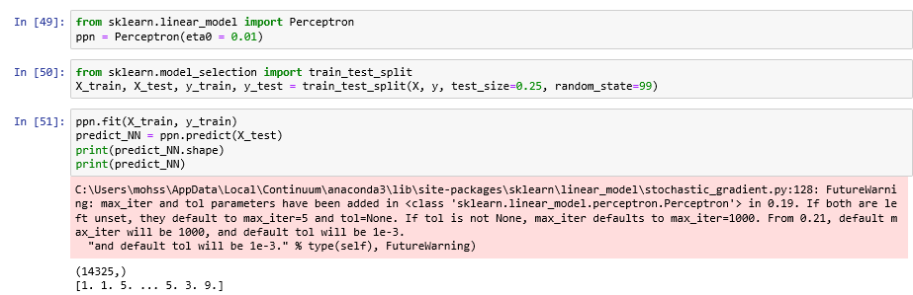
Implementation Neural Network
Scikit learn implementation for neural network

Slide 46
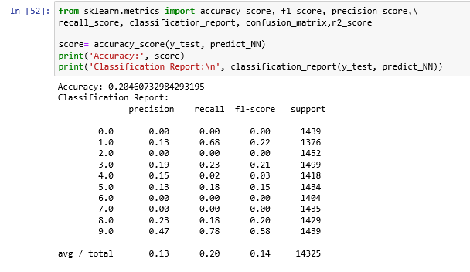
Implementation Neural Network
Scikit learn implementation for neural network

Slide 47
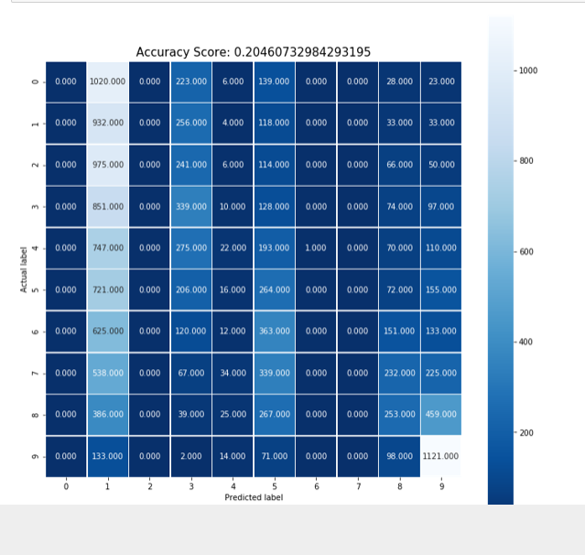
Implementation Neural Network
Scikit learn implementation for neural network

